Slide 1

ICDS Mini Hackathon - 2021
Team
Data Geeks
K. Sutharsan
I. Jayatharan
S. Piramilan
Y. Dilaxiha

Slide 2
Google Vision API
Google Cloud Vision allows us to do very powerful image processing.
Google Vision API provides a RESTful interface that quickly analyses image content.
It allows us to easily integrate vision detection features face and landmark detection, optical character recognition (OCR) etc.…

Slide 3
Approach
We tried to get the bounding box coordinates of the words which have the phrase “total”
Then we checked the bounding boxes which are in the center line of the previous bounding box.
Then we looked for floating-point numbers inside the bounding boxes.
Finally, we got the maximum floating-point number from them as the total value.

Slide 4
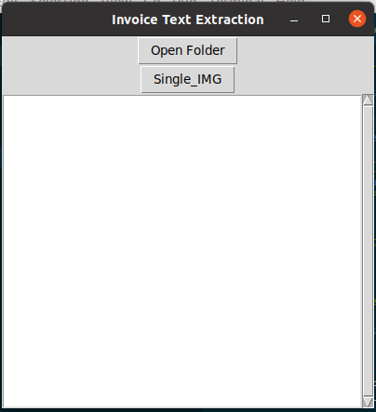
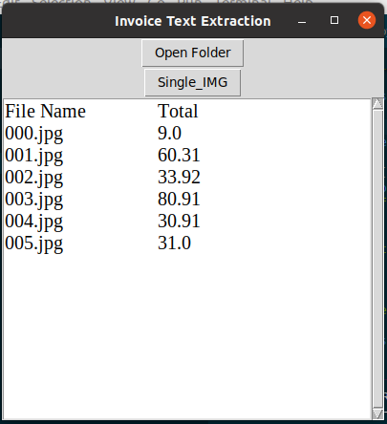
We tried to build an app which takes a set of invoice images as input and give the total bill value with corresponding image names as output.
Figure 1: Interface of the APP
Figure 2: App interface with output

Slide 5
Challenges
The bills had several names for TOTAL
We couldn’t be able to identify any model for extract the total bill amount

Slide 6


